Slide 1
ietf-ccamp-yang-otn-slicing
GitHub: https://github.com/aguoietf/ietf-ccamp-yang-otn-slicing
Document format
Propose to use Kramdown for easily tracking changes
.txt, .docx versions also uploaded

Slide 2
Issue Tracking
https://github.com/aguoietf/ietf-ccamp-yang-otn-slicing/issues

Slide 3
Proposed Call Schedule
Weekly or Bi-weekly
Candidate time slots
Doodle poll: https://doodle.com/poll/8eb8iabyhx2vewyi
Tue 10-11am EST / 10-11pm China / 4-5pm Europe
Wed 8-10am EST / 8-10pm China / 2-4pm Europe
Thu 9-10am EST/ 9-10pm China / 3-4pm Europe
Fri 8-10am EST / 8-10pm China / 2-4pm Europe

Slide 4
Functional Diagram of OTN-SC
Orchestrator/E2E SC
NSC NBI
IETF-NSC
OTN-SC NBI
OTN-SC
Reference to the other draft
MPI
PNC

Slide 5
OTN-SC Deployment Scenarios
Orchestrator/E2E SC
Orchestrator/E2E SC
Orchestrator/E2E SC
Orchestrator/E2E SC
NSC NBI
NSC NBI
NSC NBI
NSC NBI
IETF-NSC
IETF-NSC
IETF-NSC
IETF-NSC
OTN-SC NBI
OTN-SC NBI
OTN-SC NBI
OTN-SC NBI
OTN-SC
OTN-SC
OTN-SC
OTN-SC
MPI
MPI
MPI
MPI
PNC
PNC
PNC
PNC

Slide 6
Expanded View of OTN-SC
IETF-NSC
NBI
Recursive (OTN-SC),
Multi-domain recursive (MPI)
OTN-SC
NBI
NBI
Non-recursive (OTN-SC),
Multi-domain recursive (MPI)
OTN-SC
OTN-SC
MPI
MPI
Non-recursive,
Single domain
L-MDSC
PNC
MPI
MPI
PNC
PNC
Notes:
Use case 1 : realization of IETF NSC at optical layer
Use case 2 : realization of IETF NSC is to use existing OTN slices to

Slide 7
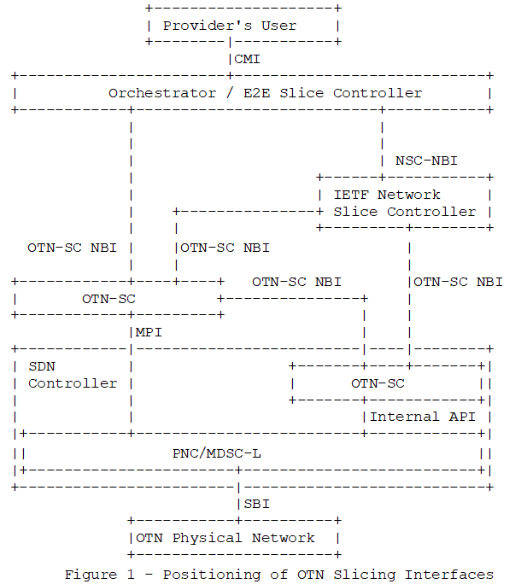
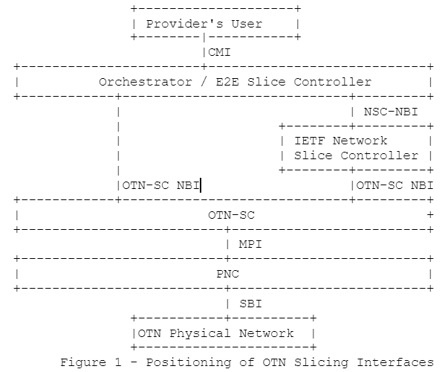
OTN-SC Figure Update

Slide 8
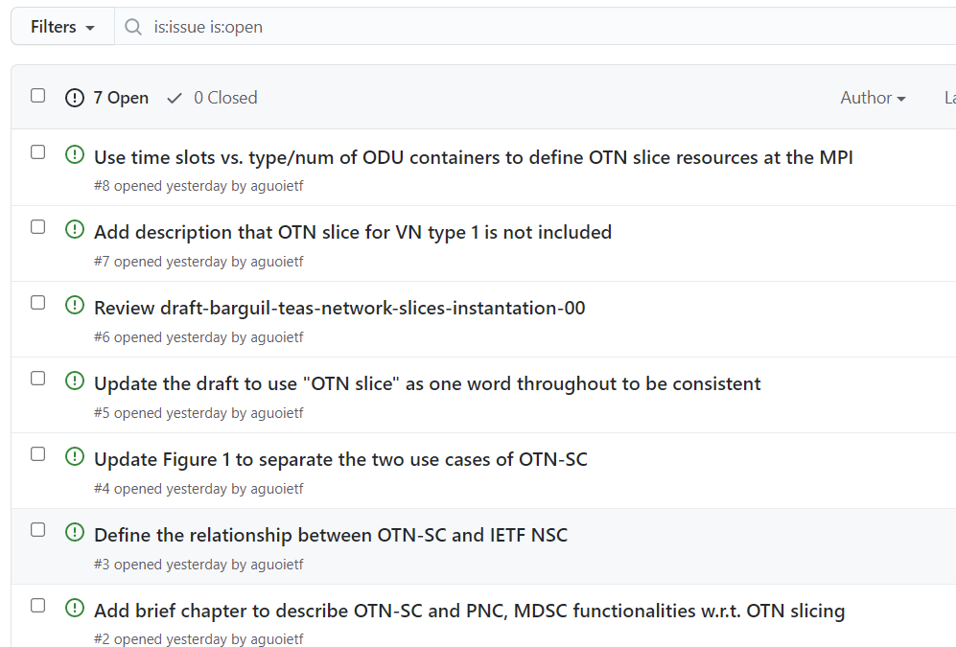
Issues - https://github.com/aguoietf/ietf-ccamp-yang-otn-slicing/issues

Slide 9
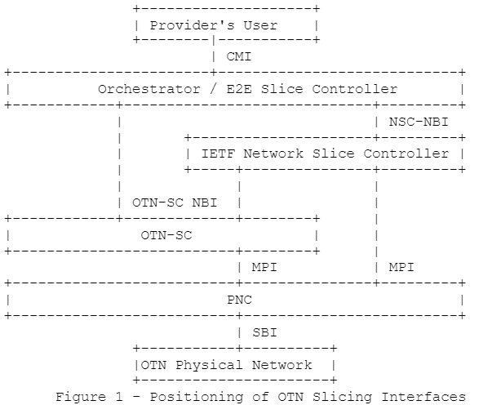
Functional Diagram of OTN-SC
Orchestrator/E2E SC
NSC NBI
IETF-NSC
OTN-SC NBI
OTN-SC
MPI
PNC
OLD
NEW

Slide 10
Scope of An OTN Slice
Single Domain
OTN Slice
Access Link
OTN Link
Access Link
CE1
X
OTN PE1
OTN PE 2
Y
Y
CE2
X
End-to-end OTN Slice
Multi Domain
OTN Slice 1
OTN Slice 2
Access Link
OTN Link
OTN Border Node
Inter-domain OTN Link
OTN Border Node
OTN Link
Access Link
CE
OTN PE
OTN PE
CE
OTN Domain 1
OTN Domain 2

Slide 11
Multi-domain OTN-SC
OTN-SC
OTN-SC
OTN-SC
MPI
MPI
OTN-SC NBI
PNC
L-MDSC
OTN-SC
OTN-SC
MPI
MPI
PNC
PNC
PNC
PNC
Single Domain
Multi Domain Option 1
Multi Domain Option 2

Slide 12
Draft-liu-teas-transport-network-slice-yang
module: ietf-network-slice
augment /nw:networks/nw:network/nw:network-types:
+--rw network-slice!
augment /nw:networks/nw:network:
+--rw network-slice
+--rw optimization-criterion? identityref
+--rw delay-tolerance? boolean
+--rw periodicity* uint64
+--rw isolation-level? identityref
augment /nw:networks/nw:network/nw:node:
+--rw network-slice
+--rw isolation-level? identityref
+--rw compute-node-id? string
+--rw storage-id? string
augment /nw:networks/nw:network/nt:link:
+--rw network-slice
+--rw delay-tolerance? boolean
+--rw periodicity* uint64
+--rw isolation-level? identityref
draft-liu-teas-transport-network-slice-yang-04 (ietf.org)

Slide 13
Draft-wd-teas-transport-slice-yang
module: ietf-network-slice
+--rw network-slices
+--rw slice-templates
| +--rw slo-template* [id]
| +--rw id string
| +--rw template-description? string
+--rw network-slice* [network-slice-id]
+--rw network-slice-id uint32
+--rw network-slice-name? string
+--rw network-slice-tag? string
+--rw network-slice-topology* identityref
+--rw network-slice-slo-group* [slo-group-name]
| +--rw slo-group-name string
| +--rw default-slo-group? boolean
| +--rw (slo-template)?
| | +--:(standard)
| | | +--rw template? -> /network-slices/slice-templates/slo-template/id
| | +--:(custom)
| | +--rw network-slice-slo-policy
| | +--rw latency
| | | +--rw one-way-latency? uint32
| | | +--rw two-way-latency? uint32
| | +--rw jitter
| | | +--rw one-way-jitter? uint32
| | | +--rw two-way-jitter? uint32
| | +--rw loss
| | | +--rw one-way-loss? decimal64
| | | +--rw two-way-loss? decimal64
| | +--rw availability-type? identityref
| | +--rw isolation-type? identityref
| | +--rw network-slice-metric-bounds
| | +--rw network-slice-metric-bound* [metric-type]
| | +--rw metric-type identityref
| | +--rw upper-bound? uint64
| +--rw network-slice-member-group* [network-slice-member-id]
| | +--rw network-slice-member-id -> /network-slices/network-slice/network-slice-member/network-slice-member-id
| +--ro slo-group-monitoring
| +--ro latency? uint32
| +--ro jitter? uint32
| +--ro loss? decimal64
+--rw status
| +--rw admin-enabled? boolean
| +--ro oper-status? operational-type
+--rw network-slice-endpoint* [endpoint-id]
| +--rw endpoint-id uint32
| +--rw endpoint-name? string
| +--rw endpoint-role* identityref
| +--rw geolocation
| | +--rw altitude? int64
| | +--rw latitude? decimal64
| | +--rw longitude? decimal64
| +--rw node-id? string
| +--rw port-id? string
| +--rw network-slice-match-criteria
| | +--rw network-slice-match-criteria* [match-type]
| | +--rw match-type identityref
| | +--rw value? string
| +--rw endpoint-ip? inet:host
| +--rw bandwidth
| | +--rw incoming-bandwidth
| | | +--rw guaranteed-bandwidth? te-types:te-bandwidth
| | +--rw outgoing-bandwidth
| | +--rw guaranteed-bandwidth? te-types:te-bandwidth
| +--rw mtu uint16
| +--rw routing
| | +--rw bgp
| | | +--rw bgp-peer-ipv4* inet:ipv4-prefix
| | | +--rw bgp-peer-ipv6* inet:ipv6-prefix
| | +--rw static
| | +--rw static-route-ipv4* inet:ipv4-prefix
| | +--rw static-route-ipv6* inet:ipv6-prefix
| +--rw status
| | +--rw admin-enabled? boolean
| | +--ro oper-status? operational-type
| +--ro endpoint-monitoring
| +--ro incoming-utilized-bandwidth? te-types:te-bandwidth
| +--ro incoming-bw-utilization decimal64
| +--ro outgoing-utilized-bandwidth? te-types:te-bandwidth
| +--ro outgoing-bw-utilization decimal64
+--rw network-slice-member* [network-slice-member-id]
+--rw network-slice-member-id uint32
+--rw src
| +--rw src-network-slice-endpoint-id? -> /network-slices/network-slice/network-slice-endpoint/endpoint-id
+--rw dest
| +--rw dest-network-slice-endpoint-id? -> /network-slices/network-slice/network-slice-endpoint/endpoint-id
+--rw monitoring-type? network-slice-monitoring-type
+--ro network-slice-member-monitoring
+--ro latency? uint32
+--ro jitter? uint32
+--ro loss? decimal64
draft-liu-teas-transport-network-slice-yang-04 (ietf.org)

Slide 14
Modeling for OTN Slices
2-in-1:
Build a topology
Single-node for connectivity-based slices
Multi-node/link topology for resource-based slices
Create connectivity on the topology
Mandatory for connectivity-based slices
Optional for resource-based slices

Slide 15
Modeling for Connectivity-based OTN Slices
Connectivity matrix - potential
Option 1: single-node topology
Endpoint list
Each endpoint has:
Endpoint id
Reference to PE LTP
(Optional) Resource id (time slot, VLAN ids etc.)
Connectivity matrix - p2p connectivity between endpoints
Committed: resource is activated
Uncommitted: resource is reserved but not activated
Default behavior of connectivity matrix
EP1
EP3
EP2
EP4
Node

Slide 16
Modeling for Connectivity-based OTN Slices
Option 2: edge-edge topology
Endpoint list
Each endpoint has:
Endpoint id
Reference to PE LTP
(Optional) Resource id (time slot, VLAN ids etc.)
Connectivity matrix - p2p connectivity between endpoints
Committed: resource is activated
Uncommitted: resource is reserved but not activated
Default behavior of connectivity matrix
Path associated with a p2p connection
EP1
TP1
TP3
EP3
Link1
path
EP2
TP2
TP4
EP4
Link2
Node1
Node2

Slide 17
Modeling for Resource-based OTN Slices
Full topology
Endpoint list
Each endpoint has:
Endpoint id
Reference to PE LTP
(Optional) Resource id (time slot, VLAN ids etc.)
SLOs
SLOs for network, link, node and TP
Connectivity matrix - p2p connectivity between endpoints
Committed: resource is activated
Uncommitted: resource is reserved but not activated
Default behavior of connectivity matrix
Path associated with a p2p connection
EP1
TP1
TP3
EP3
Link1
EP2
TP2
TP4
EP4
Node1
Link2
Link3
Node2
TP5
Node3
EP5

Slide 18
Base Model for Slicing
Base model should be technology-agnostic
Network slice as a topology
Connectivity matrix
Technology-agnostic SLO policies
slice, node, link, TP (endpoint), connection (in connectivity matrix)
Base model candidates
draft-liu-teas-transport-network-slice-yang
Define connectivity matrix
Define endpoints (mark access TPs as endpoints?)
Define SLO for endpoint and connections
draft-ietf-teas-actn-vn-yang
Remove “ACTN” in the title
Disentangle with TE topology
Move SLO definitions to VN from TE connectivity matrix
Remove steps for VN compute
draft-ietf-teas-ietf-network-slice-nbi-yang
Missing support resource-based slicing (partitioning)
SLOs are packet-specific

Slide 19
How do we merge these candidate base models?
module: ietf-vn
+--rw access-point
| +--rw ap* [ap-id]
| +--rw ap-id ap-id
| +--rw vn-ap* [vn-ap-id]
| +--rw vn-id? -> /virtual-network/vn/vn-id
| +--rw vn-ap-id ap-id
| +--rw vn-node -> /virtual-network/vn/vn-topology/node/node-id
| +--ro vn-ap-slo
+--rw network-topology
| +--rw topology* [topology-id]
| +--rw topology-id
| +--rw node [node-id]
| | +--rw slo
| +--rw link [link-id]
| | +--rw slo
| +--rw tp [tp-id]
| +--rw slo
+--rw virtual-network
+--rw vn* [vn-id]
+--rw vn-id vn-id
+--rw vn-topology-id ->/network-topology/topology/topology-id
+--rw vn-member* [vnm-id]
| +--rw src vn-ap
| +--rw dst vn-ap
| +--rw underlay-path
| +--rw slo
+--rw slo
VN + draft-liu ?
Define VN as a network topology (rename VN as “slice” ? )
Keep the definition of AP and VN-AP (maybe align with the “endpoint” naming)
AP points to TPs in the topology
Keep vn-member (rename it as “connectivity matrix” ?)
Underlay path pointing to set of links/tps in network topology
Define technology-agnostic SLO policies
vn, node, link, TP (endpoint), connection (in connectivity matrix)

Slide 20
How do we merge these candidate base models?
module: ietf-vn
+--rw access-point
| +--rw ap* [ap-id]
| +--rw ap-id ap-id
| +--rw vn-ap* [vn-ap-id]
| +--rw vn-id? -> /virtual-network/vn/vn-id
| +--rw vn-ap-id ap-id
| +--rw vn-node -> /virtual-network/vn/vn-topology/node/node-id
| +--ro vn-ap-slo
+--rw network-topology
| +--rw topology* [topology-id]
| +--rw topology-id
| +--rw node [node-id]
| | +--rw slo
| +--rw link [link-id]
| | +--rw slo
| +--rw tp [tp-id]
| +--rw slo
+--rw virtual-network
+--rw vn* [vn-id]
+--rw vn-id vn-id
+--rw vn-topology-id ->/network-topology/topology/topology-id
+--rw vn-member* [vnm-id]
| +--rw src vn-ap
| +--rw dst vn-ap
| +--rw underlay-path
| +--rw slo
+--rw slo
VN + draft-liu + draft-teas-ns
Changing names
VN – network slices
Access point – endpoints
Service mapping + VN = NS ?

Slide 21
TEAS Interim Meeting on Network Slicing
Endpoints & scope of a network slice
|<---------------------- (1) ---------------------->|
| |
| |<-------------------- (2) -------------------->| |
| | | |
| | |<----------- (3) ----------->| | |
| | | | | |
| | | |<-------- (4) -------->| | | |
| | | | | | | |
V V AC V V V V AC V V
+-----+ | +-----+ +-----+ | +-----+
| |--------| | | |--------| |
| CE1 | | | PE1 |. . . . . . . . .| PE2 | | | CE2 |
| |--------| | | |--------| |
+-----+ | +-----+ +-----+ | +-----+
^ ^ ^ ^
| | | |
| | | |
Customer Provider Provider Customer
Edge 1 Edge 1 Edge 2 Edge 2
Figure 1 : Positioning IETF Network Slice Endpoints
(1) If the CE is operated by the IETF Network Slice service provider,
then the edge of the IETF Network Slice may be within the CE. In
this case the slicing process may utilize resources from within
the CE such as buffers and queues on the outgoing interfaces.
(2) The IETF Network Slice may be extended as far as the CE, to
include the AC, but not to include any part of the CE. In this
case, the CE may be operated by the customer or the provider.
Slicing the resources on the AC may require the use of traffic
tagging (such as through Ethernet VLAN tags) or may require
traffic policing at the AC link ends.
(3) In another model, the endpoints of the IETF Network Slice are the
customer-facing ports on the PEs. This case can be managed in a
way that is similar to a port-based VPN: each port (AC) or
virtual port (e.g., VLAN tag) identifies the IETF Network Slice
and maps to an IETF Network Slice endpoint.
(4) Finally, the endpoint of the IETF Network Slice may be within the
PE. In this mode, the PE classifies the traffic coming from the
AC according to information (such as the source and destination
IP addresses, payload protocol and port numbers, etc.) in order
to place it onto an IETF Network Slice.

Slide 22

TEAS Interim Meeting on Network Slicing
Allowing for multiple connectivity matrices in a network slice
Consider the definition of connectivity matrix in the current draft and as discussed in issue #1. A consumer may want multiple connectivity matrices in their "contract" with the provider. In the example with four edge nodes (A, B, C, D), their may be traffic that flows between some edges, but not between others. For example, a consumer may want a slice that is ultra-low latency, and they may know that they want to send traffic from A to B, from A to C and multicast from D to A, B, and C. It is, of course, possible to express this as three separate slices. And this is perfectly acceptable. We must not make any definitions that prevent this from being the case. However, it seems likely that the consumer (and the operator) would prefer to talk about "the consumer's low latency slice". That is, to bundle these three connections into one construct. However, they are distinctly different connections and must be understood as such. Indeed, they may have some different SLOs associated (for example, A-B may require more bandwidth than A-C). By allowing (but not mandating) multiple connectivity matrices in a single slice service, we facilitate this administrative group. One could also imagine (but I do not pre-judge the network slice service YANG model definition) a default set of SLOs that apply to all connectivity matrices in a slice, and specific modified SLOs per connectivity matrix. Now, to Igor's point. This is about how traffic arriving at an edge (say a PE) is mapped to the correct connection. I promised a Venn diagram, but words are easier If we take the model of a port-based VPN, then one approach might be to map the (virtual or physical) port number or VLAN ID to the network slice. But clearly (and this was Igor's point) this doesn't identify the connectivity matrix if there is more than one matric per slice. A solution I offered is that the VLAN ID could identify {slice, connectivity matrix}. At that PE, for a given AC to a CE, it is necessary to expose with a separate VLAN ID for each {slice, connectivity matrix}. That does not mean: - we need a global unique identifier for each connectivity matrix - we need a per-PE unique identifier for each connectivity matrix

Slide 23
TEAS Interim Meeting on Network Slicing
-- -- --
|CE| |CE| |CE|
-- -- --
AC : AC : AC :
---------------------- -------
( |PE|....|PE|....|PE| ) ( IETF )
( --: -- :-- ) ( Network )
( :............: ) ( Slice )
( IETF Network Slice ) ( ) Customer
---------------------- ------- View
........................\........./..................
\ / Controller
>>>>>>>>>>>>>>> Grouping/Mapping v v View
^ -----------------------------------------
^ ( |PE|.......|PE|........|PE|.......|PE| )
------------ ( --: -- :-- -- )
| | ( :...................: )
| Controller | ( Network Resource Partition )
| (NSC) | -----------------------------------------
| | |
| |>>>>> Resource Partitioning |
------------ of Available Topology |
v v v
v v ----------------------------- --------
v v (|PE|..-..|PE|... ..|PE|..|PE|) ( )
v v ( :-- |P| -- :-: -- :-- ) ( Filter )
v v ( :.- -:.......|P| :- ) ( Topology )
v v ( |P|...........:-:.......|P| ) ( )
v v ( - Filter Topology ) --------
v v ----------------------------- A
v >>>>>>>>>>>> Topology Filter A /
v .......................\............../..............
v \ / Physical Network
v ------------------------------------------------
v ( |PE|.....-.....|PE|....... |PE|.......|PE| )
v ( -- |P| -- :-...:-- -..:-- )
>>>>>>>>>( : -:..............|P|.........|P| )
( -.......................:-:..- - )
( |P|..........................|P|......: )
( - - )
------------------------------------------------
Realization architecture and “filter topology”
The Physical Network may be filtered into a number of Filter Topologies. Filter actions may include selection of specific nodes and links according to their capabilities and are based on network- wide policies. The resulting topologies can be used to host IETF Network Slices and provide a useful way for the network operator to know that all of the resources they are using to plan a network slice meet specific SLOs. This could be an offline planning activity or could be performed dynamically as new demands arise.
The use of Filter Topologies is entirely optional in the architecture and IETF Network Slices could be hosted directly on the Physical Network.

Slide 24
Generic Model (Xufeng’s Proposal)
augment /nw:networks/nw:network/nw:node:
+--rw te-node-id? te-types:te-node-id
+--rw te!
+--rw te-node-attributes
| +--rw admin-status? te-types:te-admin-status
| +--rw activated boolean <== augmentation
| +--rw connectivity-matrices
| | +--rw connectivity-matrix* [id]
| | +--rw id uint32
| | +--rw activated boolean <== augmentation

Slide 25
Generic Model (VN+draft-liu)
module: ietf-ns-generic
+--rw access-point
| +--rw ap* [ap-id]
| +--rw ap-id ap-id //access point id (pre-negotiated between CE-PE)
| +--rw pe-node-id string //PE node identifier
+--rw network-slice* [ns-id]
+--rw ns-id string
+--rw ns-description string
+--rw customer-name* string
+--rw ns-type? identityref // type of network slice: type 1 or type 2
+--rw slo // SLO/SLE policy of the network slice
| +-- ...
+--rw network-topology //network topology (single-node, multi-node
| +--rw topology* [topology-id] // schema-mount of draft-liu?
| +--rw topology-id
| +--rw node [node-id]
| | +--rw slo
| +--rw link [link-id]
| | +--rw slo
| +--rw tp [tp-id]
| +--rw slo
| +--rw is-endpoint? Boolean
| +--rw ap-id? ->/access-point/ap/ap-id
+--rw connectivity-matrices
+--rw connectivity-matrix* [connectivity-matrix-id]
+--rw connectivity-matrix-id uint32
+--rw network-topology-id ->/network-slice/network-topology/topology/topology-id
+--rw src-endpoint ->/network-slice/network-topology/topology/tp/tp-id
+--rw dst-endpoint ->/network-slice/network-topology/topology/tp/tp-id
+--rw underlay-path[index]
| +--rw index uint16
| +--rw node-id ->/network-slice/network-topology/topology/node/node-id
| +--rw tp-id ->/network-slice/network-topology/topology/tp/tp-id
| +--rw slo
+--rw slo
EP1 – TP
TP1
Link1
TP3
EP3
EP2 - TP
TP2
TP4
EP4
Node1
Link2
Link3
Node2
TP5
Node3
EP5

